Slide 1


PARTNER TRAINING
Presented by Neil Davidson

Slide 2
INTRODUCTIONS
Display Technologies Ltd was founded in 2016 by business partners Neil Davidson and Simon Ridley.
The company specialises in the development of projector screens and innovative accessories for projector systems.
Our focus on the combination of technical performance and design for install ensure that Display Technologies creates solutions that meet the needs of both the client and the installer.
Display Technologies never accept second best and in our short history have already made several advances in projection screen design – particularly the incredible Dynamic series masking screens featuring Mask Position Logic, the only masking screens that are driven by aspect ratio not presets.

Slide 3
WHY DT SCREENS
The only screens designed from scratch around ease of install
Multiple unique technologies create a smarter and better product
We have not been constrained by off the shelf solutions – where a new solution was required
to deliver performance we have invested in the new solution
DT Screens ARE the number one brand for
  Performance
  Ease of Install and Use
  Dealer Support

Slide 4


Slide 5
DT SCREENS IMAGE SURFACES
DT Screens offer several image surfaces to support several different applications
ACOUSTIC TRANSPARENT
AT-Ref – 0.93 Gain white surface – The finest AT Surface for screens up to 1.8m (6ft) tall
AT-XL – 0.9 Gain white surface – High Performance AT Surface for screens up to 3m (10ft) tall
AT-XXL – 0.89 Gain white surface – High Performance AT Surface for screens up to 4.5m (15ft) tall
AMBIENT LIGHT REJECTING
USTP – 0.75 Gain ALR surface – The finest ALR solution for ultra short throw front projection
REAR PROJECTION
RPG – 0.7 Gain glass surface – The ideal RP surface for all applications including ultra short throw

Slide 6
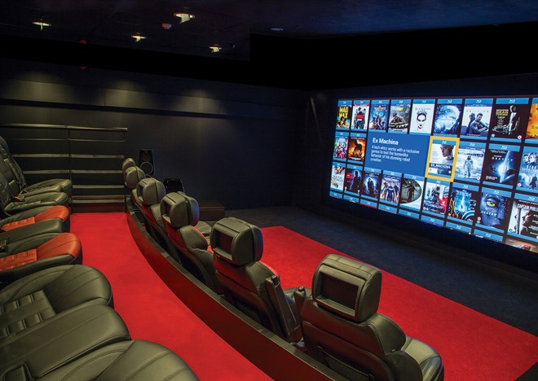
AT Ref

Slide 7
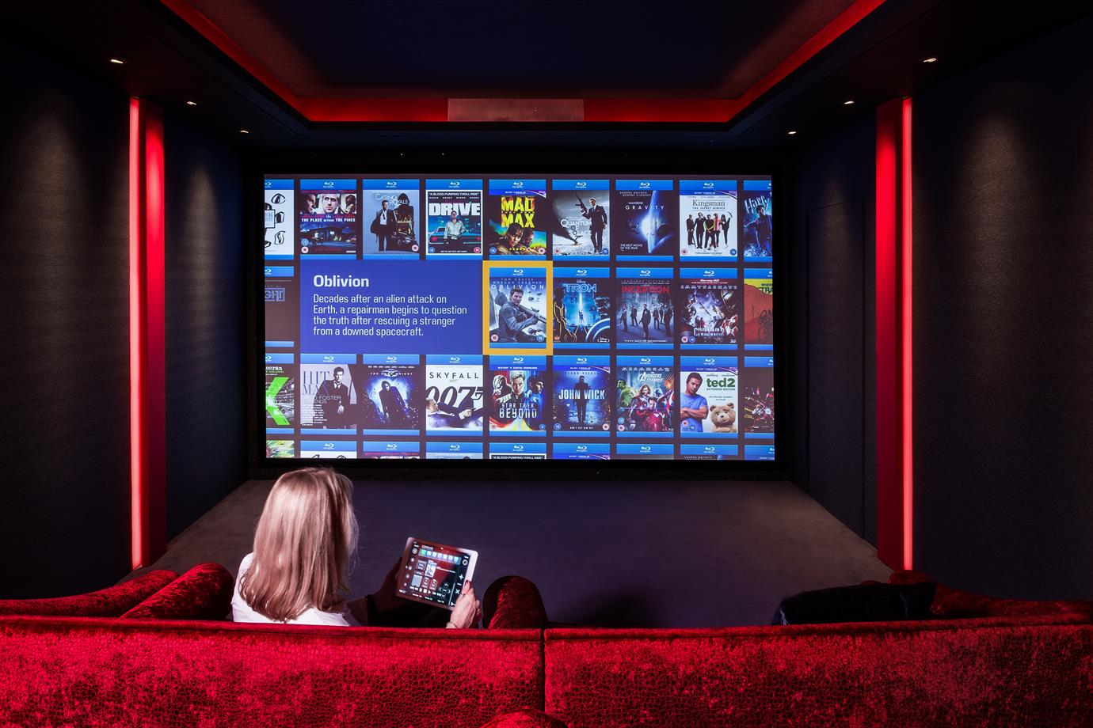
AT XL

Slide 8
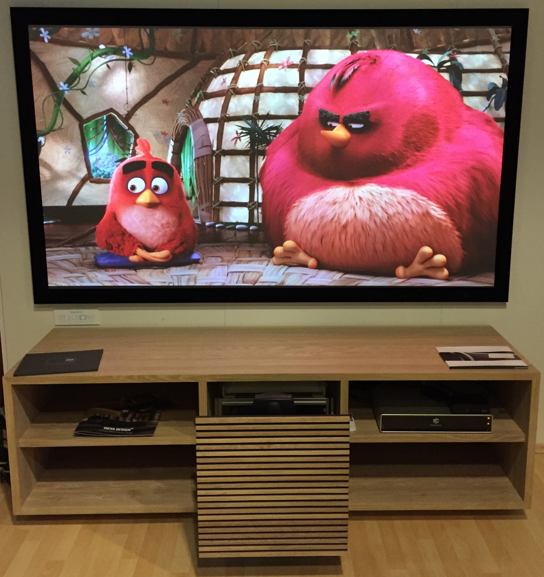
USTP

Slide 9
DT SCREENS MODELS
There are a simple range of screens that are designed to progress to cover almost any requirement
CONTEMPO - Micro Frame Screen
FRONTIER - Modern Velvet Frame Screen
DYNAMIC - Multiway Masking Screen

Slide 10
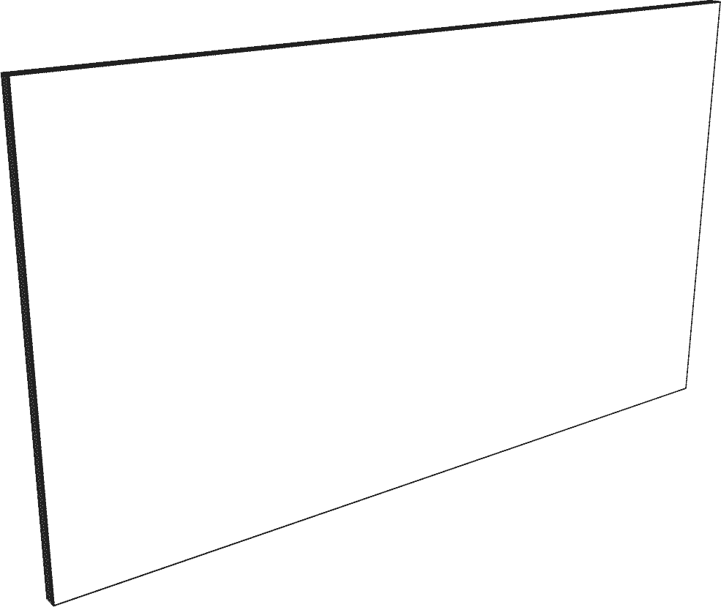
CONTEMPO
2mm (0.08”) wide front bezel
32mm (1.26”) deep
Comes as standard in Black powder coat finish
Custom frame finishes on request
Features:
  Through frame mounting
  Front loading image surface

Slide 11
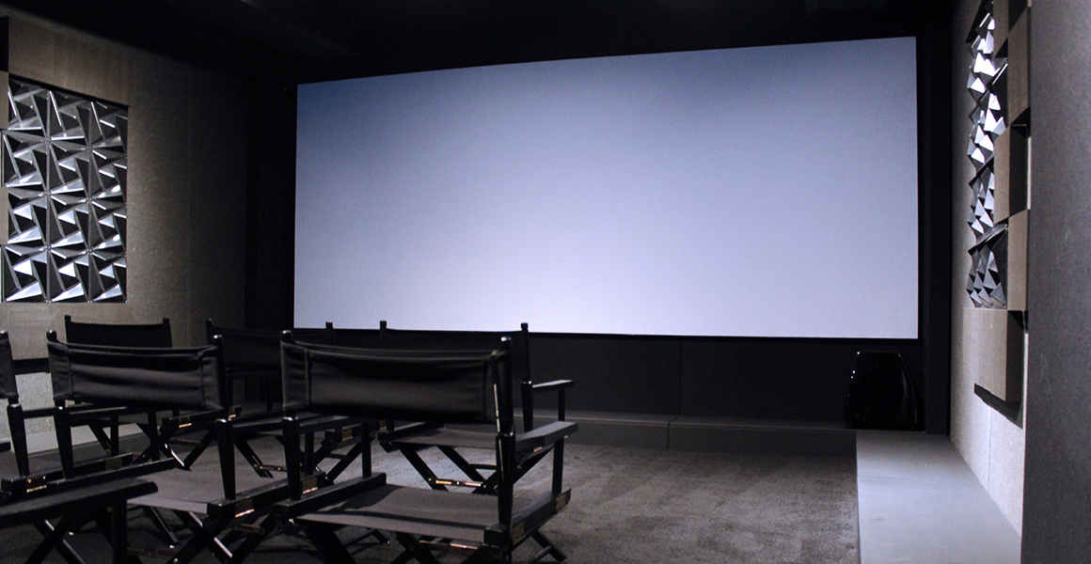

CONTEMPO

Slide 12
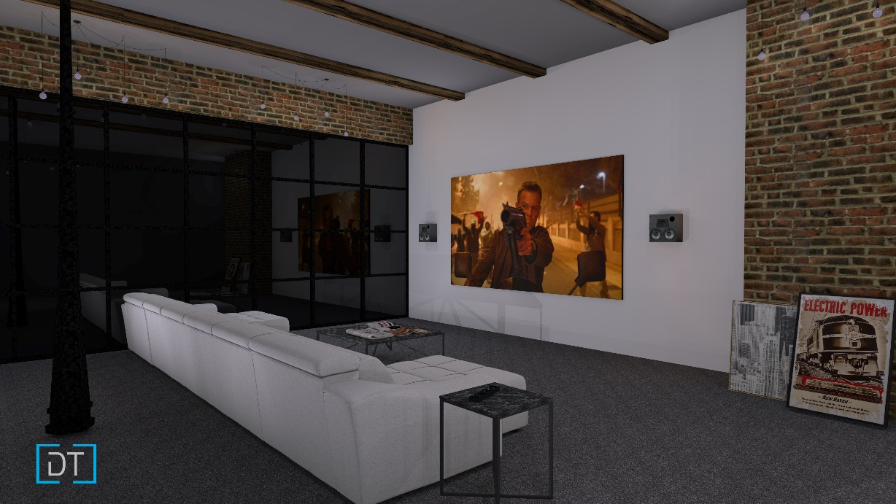
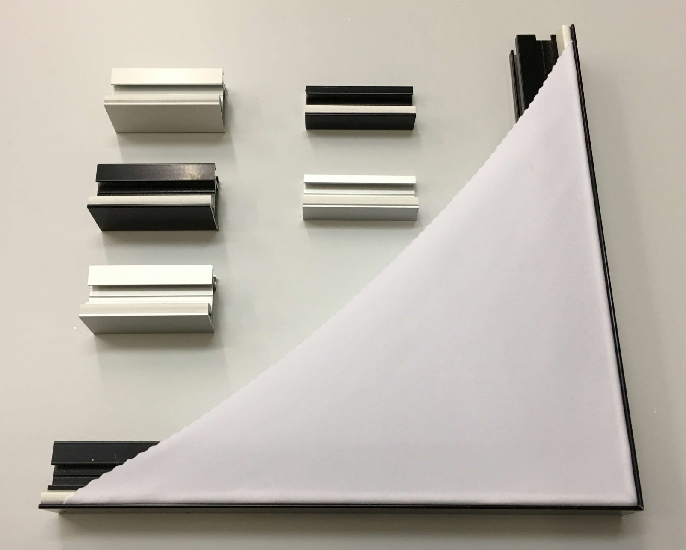
CONTEMPO

Slide 13
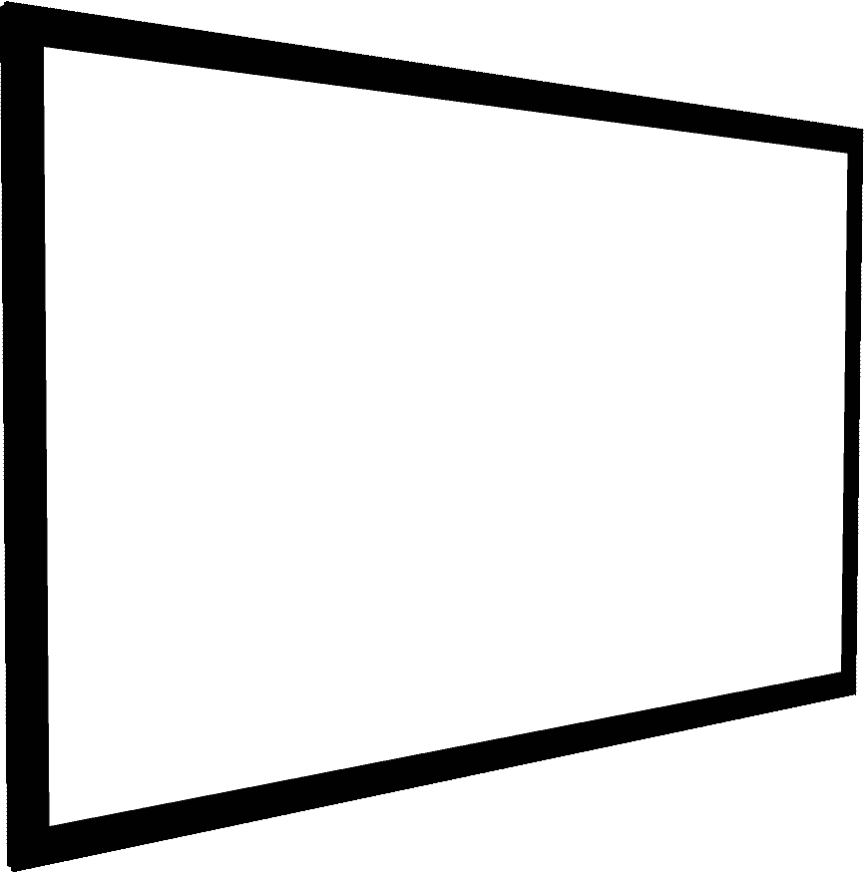
FRONTIER
69mm (2.72”) wide front bezel
36mm (1.42”) deep
Comes as standard in veBlack finish
Custom frame finishes on request
Features:
  Through frame mounting
  Front loading image surface
  Magnetic front bezel

Slide 14
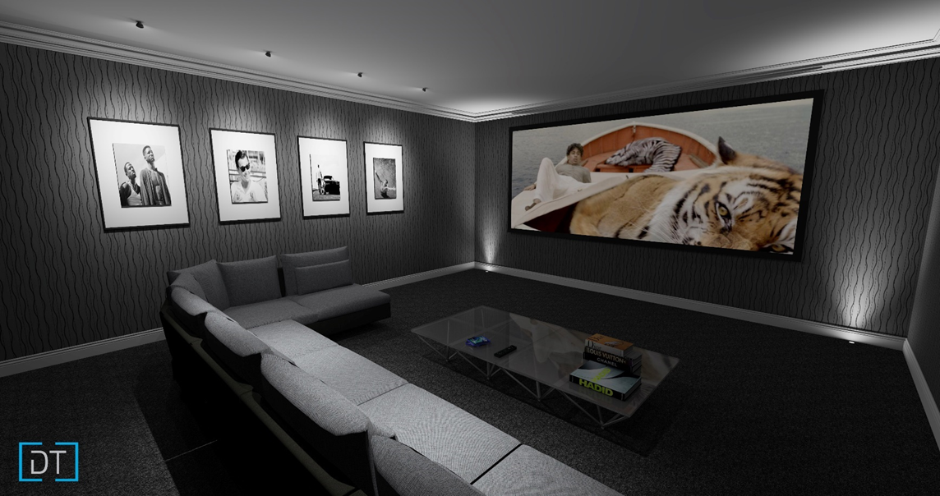
FRONTIER

Slide 15
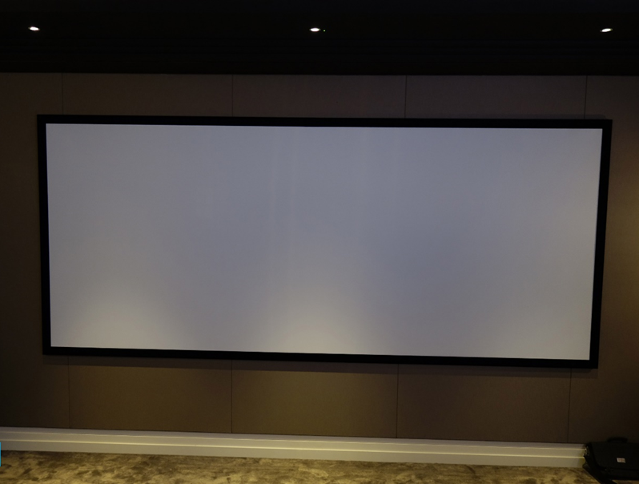
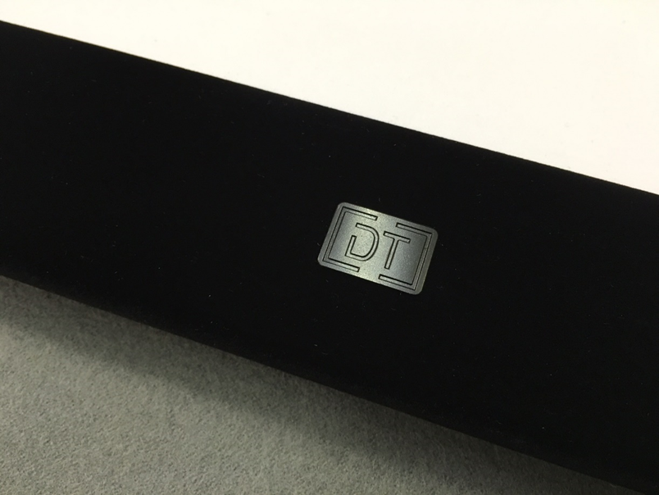
FRONTIER

Slide 16
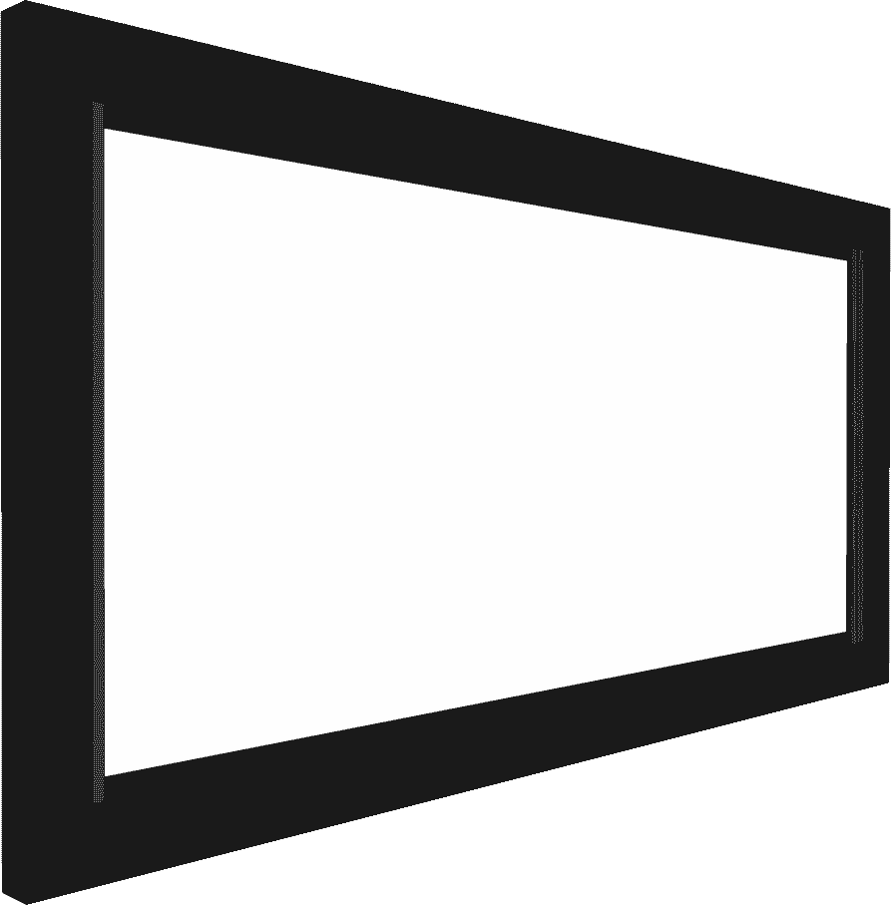
DYNAMIC
200mm (7.9”) wide front bezel
From 127mm (5”) deep
Comes as standard in veBlack finish
Custom frame finishes on request including in wall style
Multiple Masking Styles
  1 way top
  2 way side or top/bottom
  4 way
  Art Mask Option available on all versions

Slide 17
DYNAMIC
Features:
  Through frame mounting
  Front loading image surface
  Magnetic front bezel
  Whispertec Package
    Whispertec Motors (<35dB)
    Whispertec Bearings on rollers and masks
    Whispertec Tension System on masks
  Mask Position Logic!

Slide 18
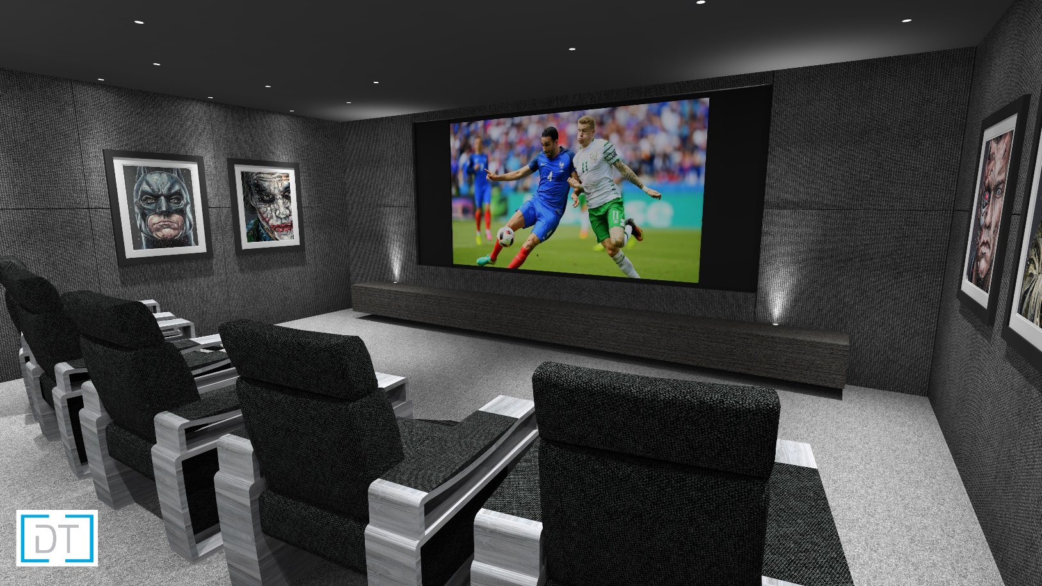
DYNAMIC

Slide 19
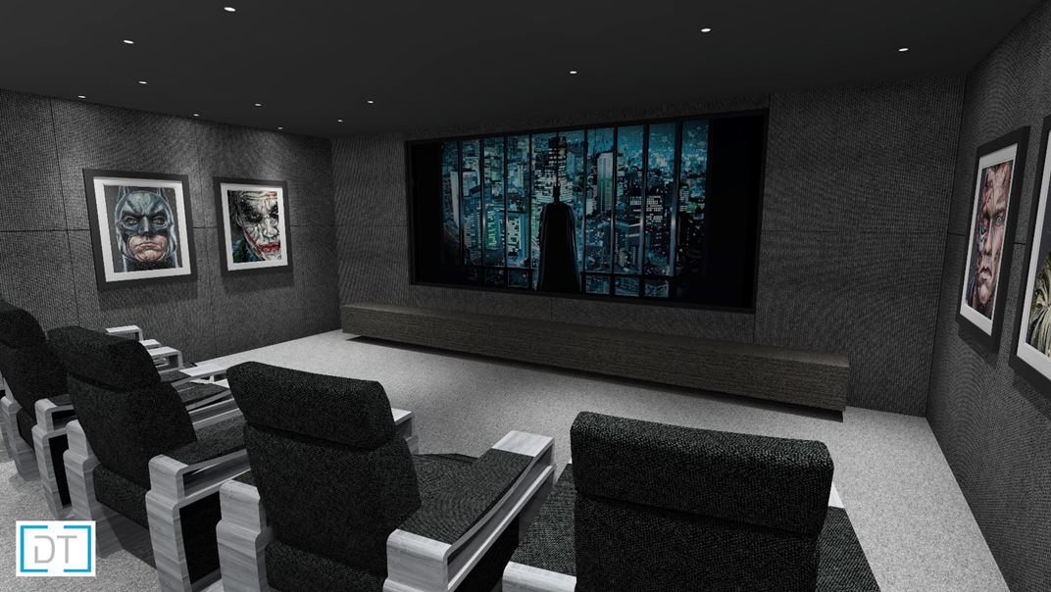
DYNAMIC

Slide 20
DT SCREENS
MASK POSITION LOGIC

Slide 21
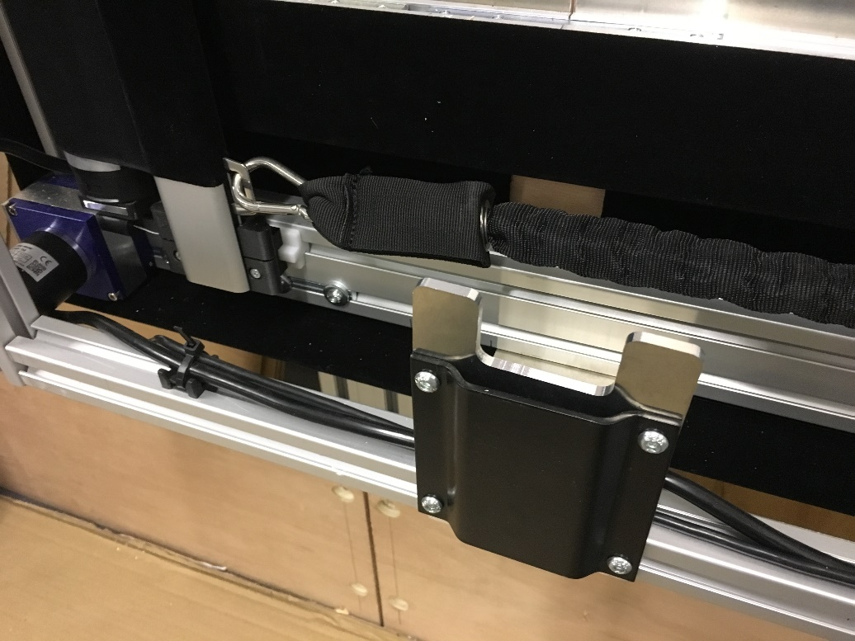
Mask Position Logic
Controller is programmed at factory with
Width / Height / Mask Config
Special sensors measure mask position to 1.5mm accuracy
Screen can be driven to specific aspect
without the use of presets
Actual commands…
  >ARV=G0185
  >ARV=G0178
  >ARV=G0237

Slide 22


Slide 23
DT MOUNTS PRODUCTS
DT Mounts offers a range of mounting brackets and accessories to make it easy to incorporate projection solutions into installs.
VMM – Vertical Mirror Mount
RPM – Rear Projection Mount
USTM – Ultra Short Throw Mount
PHG – Port Hole Glass
ACM – Adjustable Ceiling Mount
MMD – Motorised Mirror Drop

Slide 24
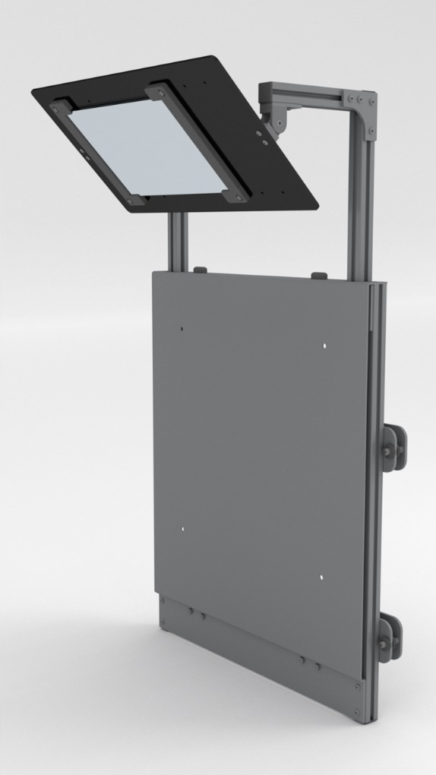
VERTICAL MIRROR MOUNT
Enables vertical install of the projector
Custom made to match the projector. Simple and fast mounting and alignment.
Available in 4 styles
VMM-UP – Lens Up , Base away from screen
VMM-DWN – Lens Down, Base away from screen
VMM-RE-UP – Lens Up, Base towards screen
VMM-RE-DWN – Lens Down, Base towards screen

Slide 25
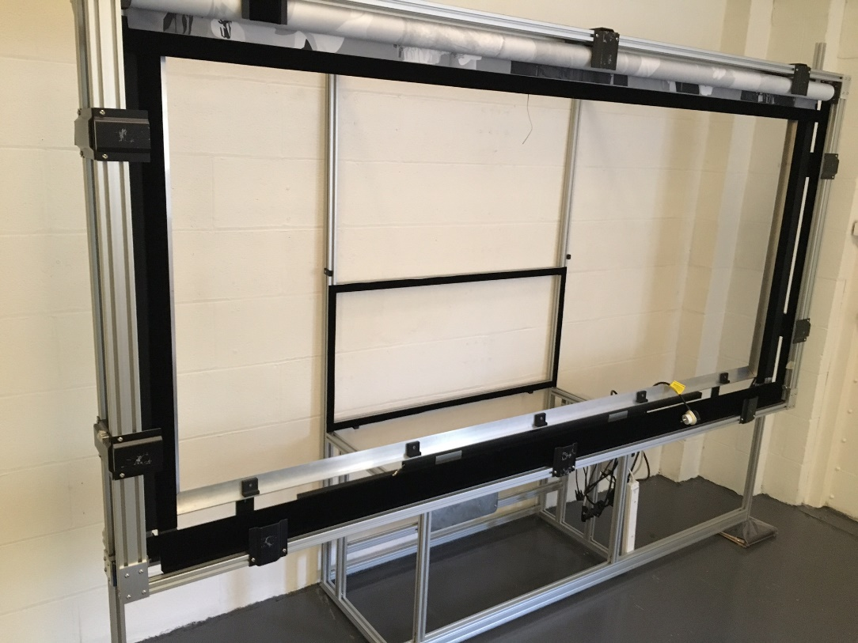
REAR PROJECTION MOUNT
Frame system for rear projection applications
Includes:
  Projector Mount
  Folding Mirror
  Frame Support System
  Compatible with Dynamic and Frontier Screens

Slide 26
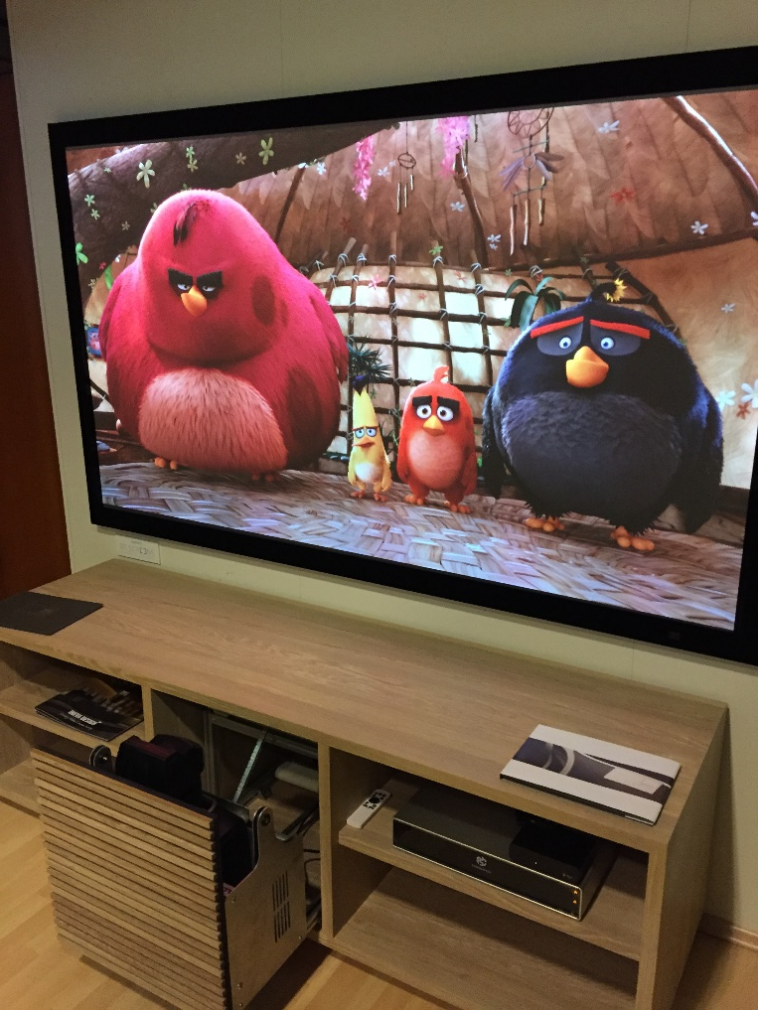
ULTRA SHORT THROW MOUNT
Motorised solution for ultra short throw front projection
Custom made to match the projector
Available in two styles
USTM-1 – Single movement solution for standard style UST projectors such as Sony, Sim2, Epson, DPI, Panasonic
USTM-2 – Dual movement solution for periscope lens style UST projectors such as Barco,

Slide 27
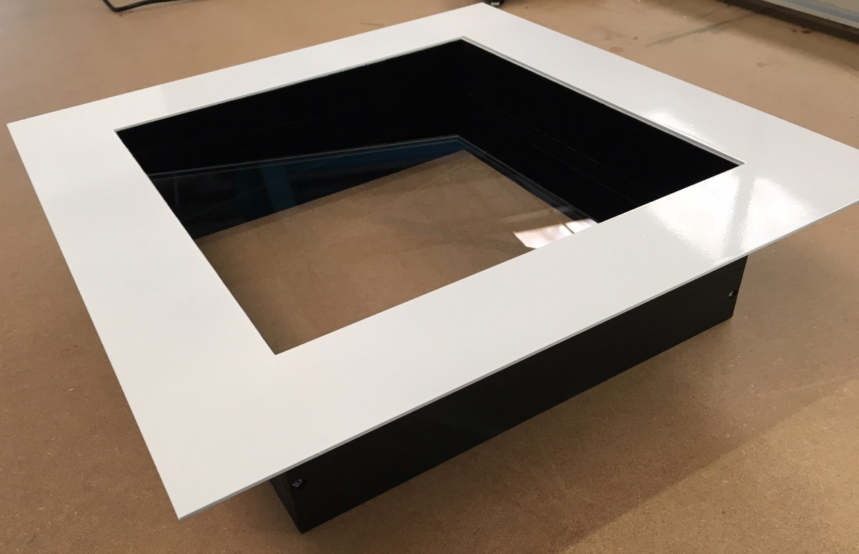
PORT HOLE GLASS
Isolation solution for projector rooms
Magnetic mounting allows quick install and easy alignment with in room finish
Comes as standard in powdercoat finish
  Black
  RAL Colours on request
  Custom options on request
Two styles available
PHG-1 – Single Glazed Unit
PHG-2 – Double Glazed Unit

Slide 28
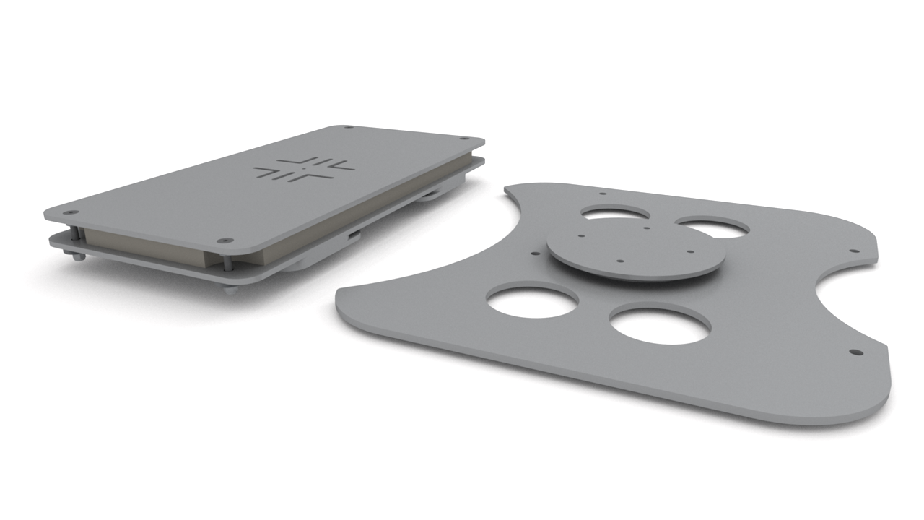
ADJUSTABLE CEILING MOUNT
Enables ceiling install of the projector
Custom made to match the projector. Simple and fast mounting and alignment.
Total depth only 55mm (2.16”)
Sandwich layer of high density foam helps to minimise vibration transfer from structure to projector

Slide 29
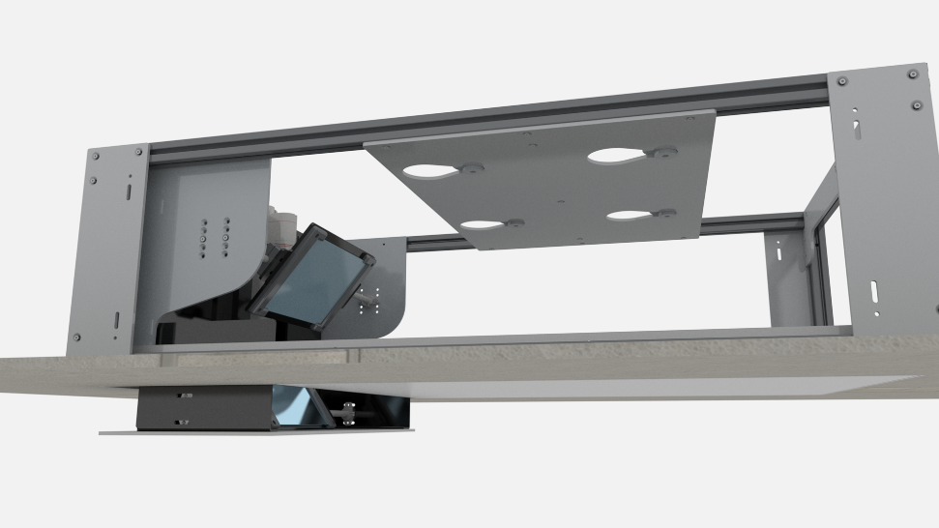
MOTORISED MIRROR DROP
Enables hidden in-ceiling install of the projector
Custom made to match the projector. Simple and fast mounting and alignment.
Three different trim options to match the required ceiling finish.
Total depth only 330mm (13”)
Moving section drops just 100mm (4”) below ceiling for minimal visual impact when in use

Slide 30


Slide 31
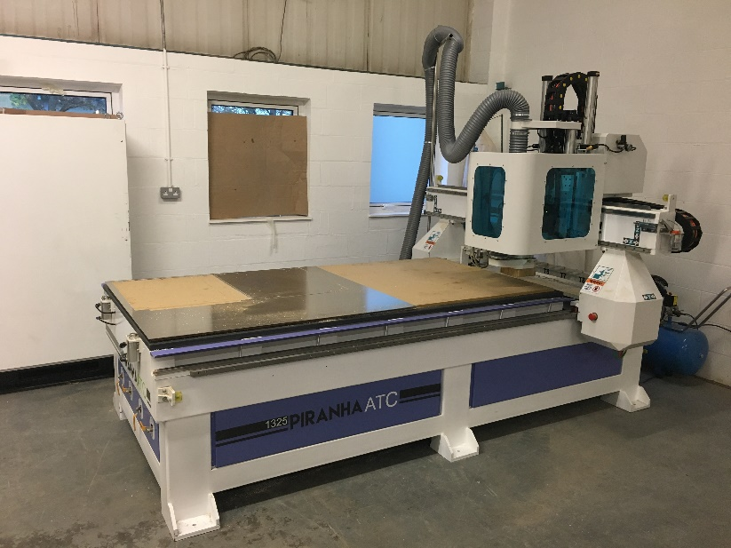
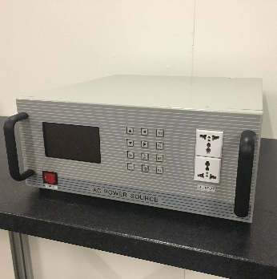
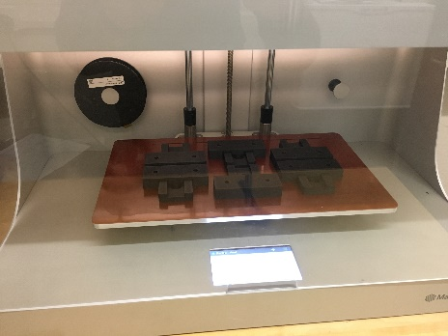
SOLUTIONS TO PROBLEMS
Display Technologies have invested in advanced production equipment and facilities
We have full CNC, 3D printing and material processing capabilities in house
We have our dedicated control platform electronics and extensive programming and electronics expertise
We have cloud based CAD and 3D tools to allow us to design and collaborate
If you need custom solutions – and you are happy to pay for engineering – we are happy to make it happen!

